Slide 1
Computer Graphics: 2D – Polygon Filling
Tommy Marrinan, PhD

Slide 2
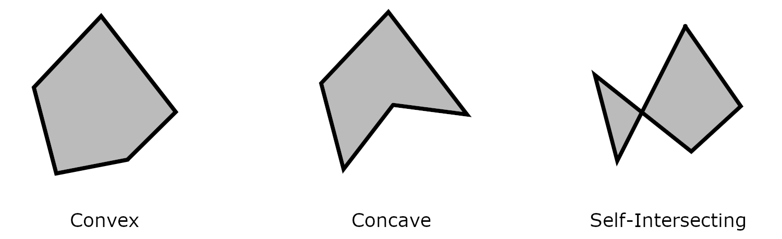
Polygon Types
Polygons defined by a sequence of vertices (v₀, v₁, … v_{n})
Edges from v_{i} to v_{i+1} and from v_{n} to v₀
Convex, concave, self-intersecting

Slide 3
Filling a Polygon
Draw a sequence of horizontal lines
1 per scan line (row of pixels)
Start at polygon’s y_{min} and go up to polygon’s y_{max}
Calculate intersections between scan line and polygon edges
Sort intersection points by x-coordinate
Draw line for each span (pair of intersections)

Slide 4
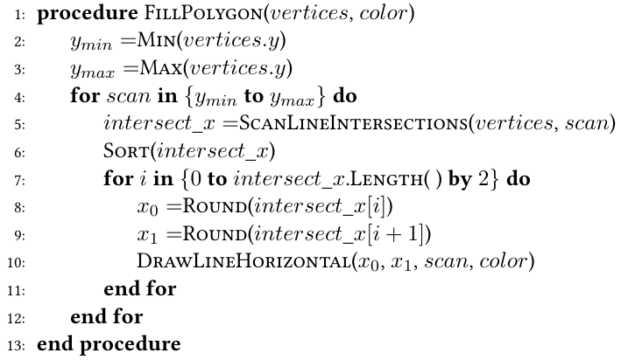
Easy, but Ineffiecient
Calculate intersections
If exactly an endpoint, add twice if local extrema, once otherwise
Checks all edges for each scan line

Slide 5
Edge Coherence Filling
Extra rules as to what “counts” as inside the polygon
Pixels within the boundary of a polygon belong to the polygon
Pixels on left edges belong to a polygon, but pixels on right edges do not
Pixels on a bottom vertex belong to a polygon, but pixels on a top vertex do not
Pixels on a horizontal edge do not belong to a polygon
Avoids drawing pixels twice for adjacent polygons

Slide 6
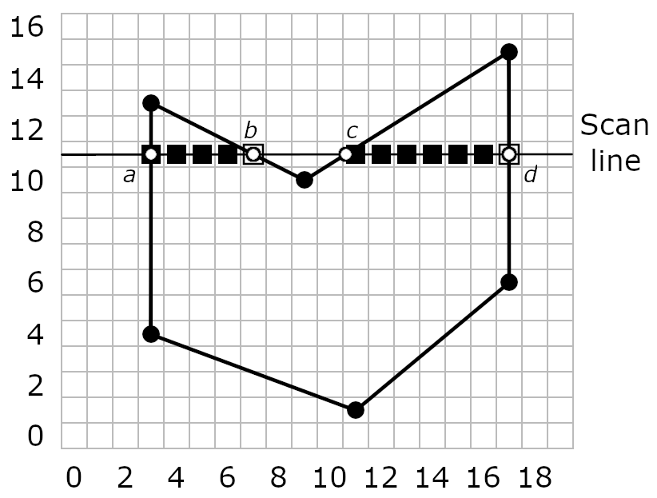
Edge Coherence Filling
Point a: left edge – illuminate
Point b: right edge – not illuminate
Point c: inside polygon – illuminate
Point d: right edge – not illuminate

Slide 7
Edge Coherence Filling
Incrementally determine intersections
Rather than computing them directly
Take advantage of the fact that most edges intersected by one scan line will intersect the next scan line too
Uses two data structures
Edge Table: stores entries for each edge in the polygon
Active List: list of edges that intersect a given scan line

Slide 8
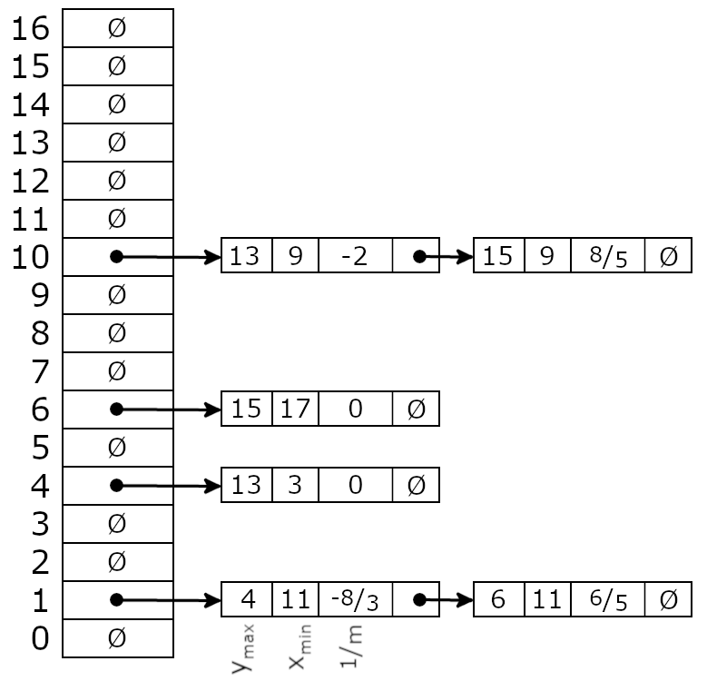
Edge Coherence Filling
Edge Table (ET)
Array: one entry per scan line
Entry
Y-coordinate of top vertex
X-coordinate of bottom vertex
1/slope: 𝚫x/𝚫y
Store entries at Y-coordinate of bottom vertex
Linked list
same y_{min} (ascending x)

Slide 9
Edge Coherence Filling
Active List (AL)
Dynamically changes
Uses same entries as the Edge Table

Slide 10
Edge Coherence Filling
Set y to first scan line in ET that is not NULL
Initialize AL to NULL
Repeat until ET[y] is NULL and AL is NULL
Move all entries at ET[y] to AL
Sort AL to maintain ascending x order
Remove entries from AL whose y_{max} equal y
Draw horizontal line for each span
Increment y by 1
Update x values for remaining entries in AL
Increment by 1/m

Slide 11
Edge Coherence Filling
Left Edge:
Round up
Right Edge
Round down
If an integer, subtract 1
Round up and subtract 1!

Slide 12
Edge Coherence Filling
What additional constraints would make this easier?
Both programming and computational efficiency
Only convex polygons
One span per row of pixels
No need to sort each time
Initially insert based on x-value
Same x-values sorted based on slope

